Slide 1

7th Obesity & NASH Drug Development Summit
Marc Thibonnier, M.D., M.Sc.
Founder & President mthibonnier@aptamir.com
Criteria for Developing
Active Cellular Targeting MicroRNAs
Oligonucleotide Therapeutics
to Cure Cardio-Metabolic Pandemics
November 2023

Slide 2
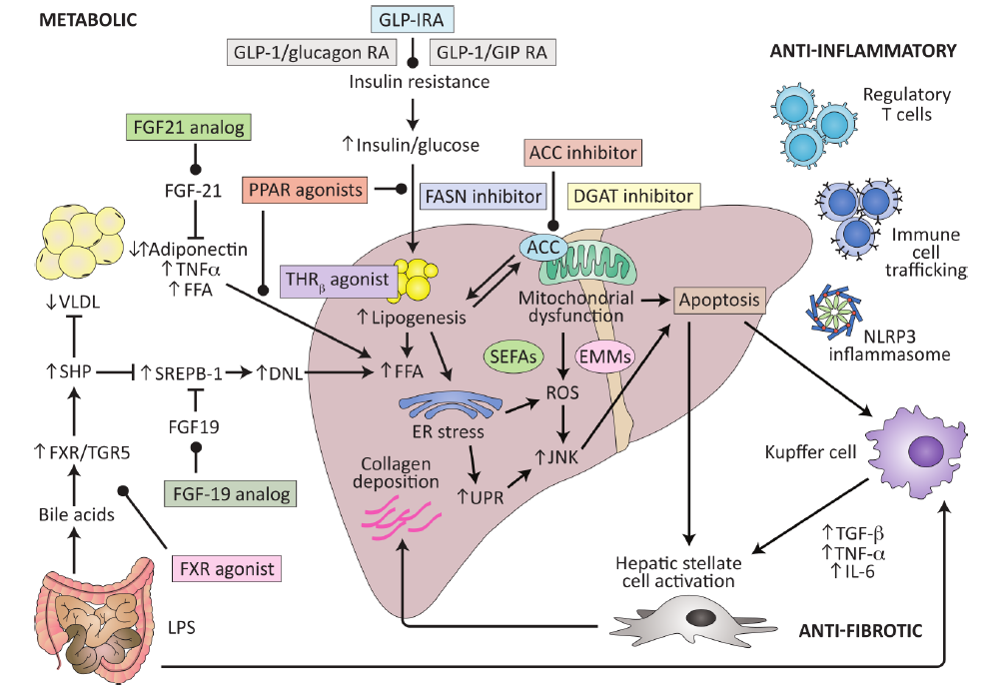
Many Therapeutic Targets for MASLD
“The complexity of the pathophysiology of the disease provide multiple potential targets for drug treatment”
Current therapies and new developments in NASH Gut 2022, www.ncbi.nlm.nih.gov/pubmed/35710299

Slide 3

New Therapies for Obesity & MASLD
Several Pharmaceutical Companies:
  Have developed GLP-1 Receptor Agonists for the treatment of Type 2 Diabetes Mellitus and/or Obesity (e.g liraglutide sc qd and semaglutide 2.4 mg sc qw)
  Are testing dual, triple and quadruple combinations of incretin analogs (agonists to the glucagon-like peptide-1 receptor (GLP-1R), glucagon receptor (GCGR) and glucose-dependent insulinotropic peptide receptor (GIPR) for the treatment of obesity and MASLD
  Achieved Body Weight reductions ≥ 15% vs placebo: e.g. Tirzepatide (GLP-1R + GIPR) Once Weekly for the Treatment of Obesity (N Engl J Med 2022; 387:205-216)
  At the June 2023 American Diabetes Association meeting, Eli Lilly once-weekly s.c. injectable drug Retatrutide (GIP/GLP 1/Glucagon Receptor GCG triple agonist peptide) was shown to achieve a 24% body weight loss over 48 weeks
  BUT:
Weight regain and cardiometabolic effects after withdrawal of semaglutide: The STEP 1 trial extension (Diabetes Obes Metab. 2022;24:1553–1564)
One year after withdrawal of once-weekly subcutaneous semaglutide 2.4 mg and lifestyle intervention, participants regained two-thirds of their prior weight loss, with similar changes in cardiometabolic variables. These findings confirm the chronicity of obesity and suggest ongoing treatment is required to maintain improvements in weight and health
The FDA has issued black box warnings for hypoglycemia, thyroid cancer and gastro-intestinal ileus

Slide 4
AptamiR’s Goal and Strategy
Goal: Treat cardiometabolic pandemics (obesity, dyslipidemia, insulin resistance, Type 2 diabetes and metabolic dysfunction-associated steatotic liver disease (MASLD)), without altering brain functions nor calories absorption, while improving patients’ quality of life
Strategy: Use the pleiotropic concept of One Drug-Multiple Targets by developing active cellular targeting microRNAs Oligonucleotide Therapeutics (ONTs) to simultaneously modulate several target genes involved in lipid oxidation, mitochondrial activity, energy expenditure, fat accumulation, inflammation and necrosis to:
Transform subcutaneous lipid-storing fat cells (White Adipocytes) into calories-burning fat cells (”Browning Effect”)
Reduce fat accumulation and body weight
Correct lipotoxicity and dyslipidemia
Improve insulin sensitivity and Type 2 Diabetes Mellitus
Reverse liver steatosis, inflammation and fibrosis
Notes:
http://themedicalbiochemistrypage.org/adipose-tissue.php

Slide 5
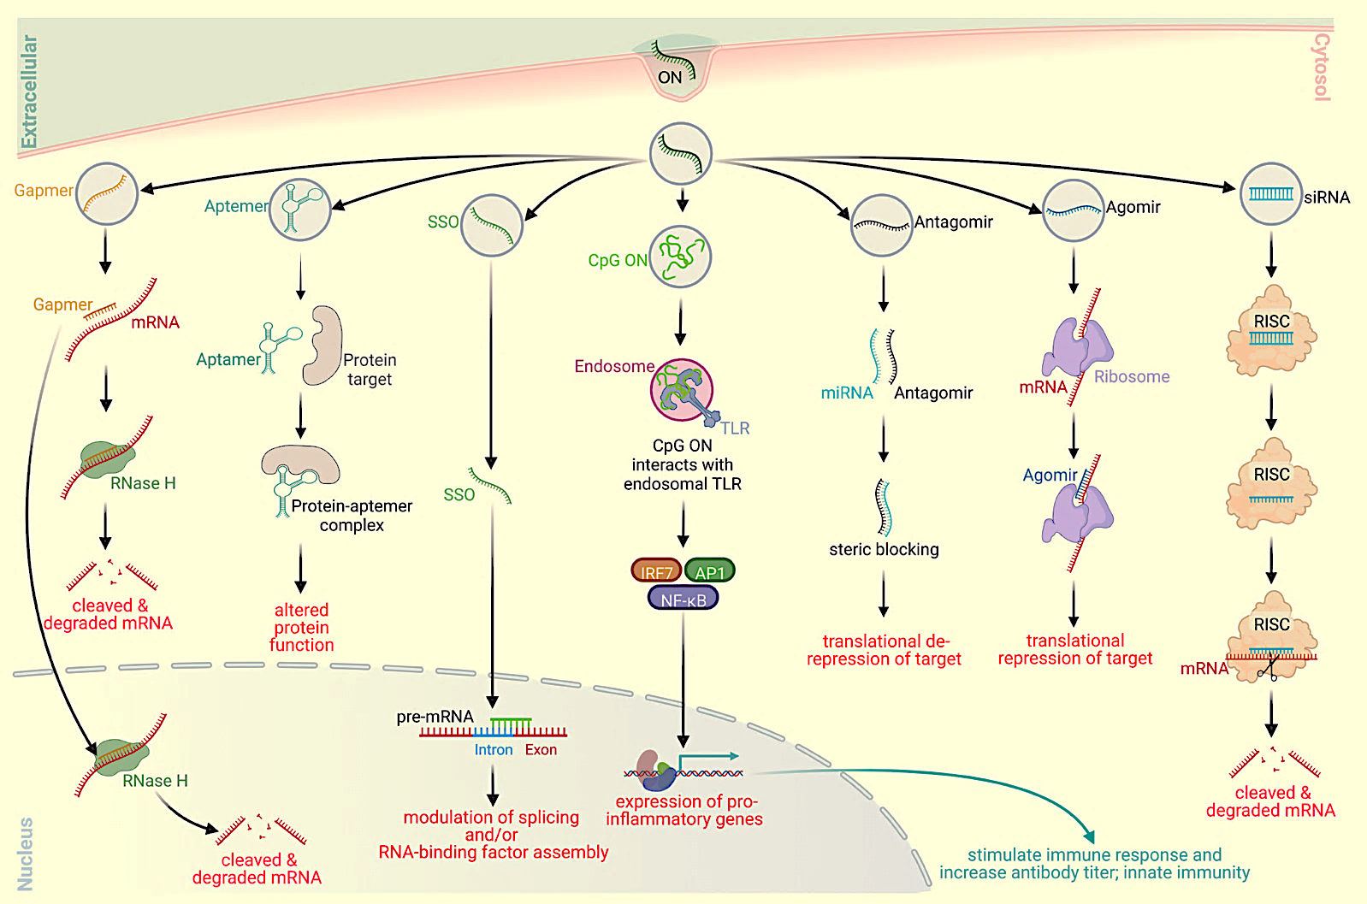
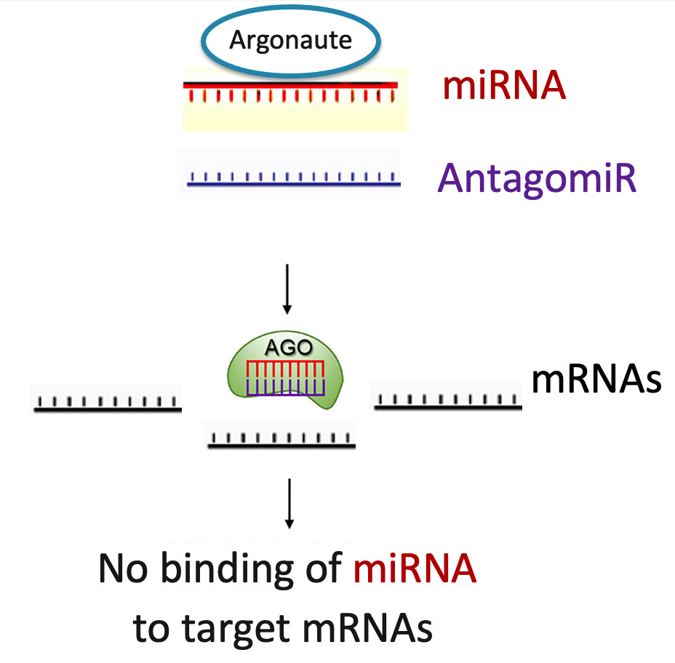
Mechanism of Action of microRNA Antagomirs
MicroRNA antagomirs act by Watson-Crick base-pairing to their complementary miRNAs, thus preventing such miRNAs to modulate their target messenger RNAs
Kilikevicius, A., Meister, G. and Corey, D.R. (2022) Nucleic Acids Res, 50, 617-634
S. Anwar, F. Mir and T. Yokota
(2023) Pharmaceutics 2023 Vol. 15 Issue 4

Slide 6
AptamiR’s 7 Criteria for Developing Generation 2.5
Active Cellular Targeting microRNA Oligonucleotide Therapeutics
1. Select a miRNA that is unique, universal, phylogenetically conserved and significantly expressed in the targeted tissues and organs of interest
2. Avoid potential toxicities by replacing the chemical modifications (Phosphorothioate (PS) and Locked Nucleic Acid (LNA)) utilized in Generation 1 & 2 ONTs with a gamma Peptide Nucleic Acid (PNA) backbone
  3. Maintain resistance to nucleases and proteases/peptidases
  4. Avoid chirality
  5. Limit binding to serum proteins
  6. Optimize and simplify chemical synthesis
  7. Conjugate the ONT to a fatty acid or a short peptide for enhanced and active targeted delivery to adipocytes and metabolic organs via the cellular membrane transporter Fatty Acid Translocase (FAT) of a greatly reduced effective dose with an extended duration of action (mean residence time, MRT)

Slide 7
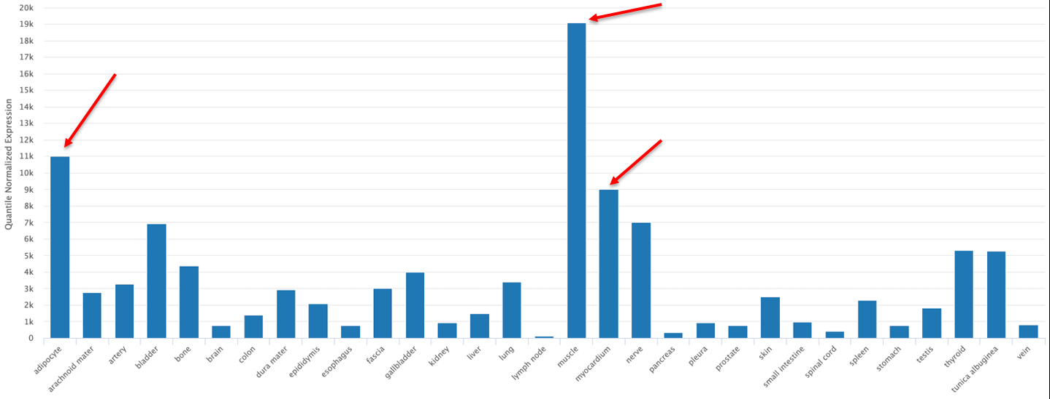
Select a miRNA that is unique, universal, phylogenetically
conserved and expressed in the targeted tissues/organs
  The sequence of miR-22-3p is unique and well conserved across species (https://www.targetscan.org/vert_80/ 0)
  The human tissue/organ distribution of hsa-miR-22-3p was examined using the TissueAtlas2 program (https://www.ccb.uni-saarland.de/tissueatlas2)
  The Tissue Specific Index (TSI) for hsa-miR-22-3p was 0.855, indicating a high tissue-specific expression pattern, especially in the adipocytes, skeletal muscle and the myocardium (red arrows):

Slide 8
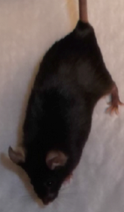
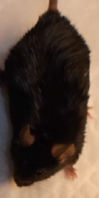
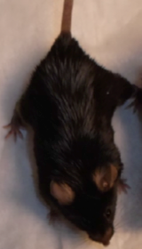
AptamiR first miR-22-3p antagomir drug candidate reduces fat mass and improves metabolic parameters in obese mice
Normal diet
60% High-fat diet
60% High-fat diet
+ anti-miR Rx
Results
Body Weight | Reduced
Fat Mass | Reduced
Lean Mass | Unchanged
Cholesterol | Improved
Glucose | Improved
Insulin Sensitivity | Preserved
Liver Tests | Normal
Temperature | Normal
Appetite | Unchanged
Energy Expenditure | Increased
Liver Steatosis | Reduced
32.08 gm
45.85 gm.
35.51 gm
Mean Body Weight at week 8 of study
- M. Thibonnier and C. Esau, Metabolic Benefits of MicroRNA-22 Inhibition, Nucleic Acid Ther 2020 Vol. 30 Issue 2 Pages 104-116
- M. Thibonnier, C. Esau, S. Ghosh, E. Wargent and C. Stocker, Metabolic and energetic benefits of microRNA-22 inhibition, BMJ Open Diabetes Res Care 2020 Vol. 8 Issue 1
- M. Thibonnier and S. Ghosh, Strategy for Pre-Clinical Development of Active Targeting MicroRNA Oligonucleotide Therapeutics for Unmet Medical Needs, Int J Mol Sci 2023 Vol. 24 Issue 8:7126

Slide 9
AptamiR miR-22 Antagomir
Reduces Liver Fat Accumulation in DIO Mice
Treatment for 12 weeks with the miR-22-3p antagomir APT-110 produced a marked reduction in fatty infiltration of the liver (H&E staining):
Saline APT-110
Thibonnier, M. et al. Metabolic Benefits of MicroRNA-22 Inhibition, Nucleic Acid Ther., 30(2), 104-116, 2020
Thibonnier, M. et al. Metabolic and Energetic Benefits of MicroRNA-22 Inhibition, BMJ Open Diabetes Res. Care, 8, 2020
Elevated circulating miR-22-3p is a biomarker of NAFLD, in relation to activity score (NAS) and Steatosis Activity Fibrosis (SAF): Scientific Reports, 8:10606, 2018
Hepatic miR-22 overexpression enhances diet and alcohol-induced steatosis whereas reducing miR-22 level improves alcoholic steatosis in mouse models: JHEP Rep. 2020;2(2), 100093
miR-22 promotes the development of liver cirrhosis through BMP7 suppression: Cell Physiol. Biochem. 2015;36:1026-1036
miR-22 modulates the expression of lipogenesis-related genes and promotes hepatic steatosis in vitro: FEBS Open Bio 2021;322-332. “miR-22 inhibitors may have potential as candidate drugs for NASH and obesity”
MicroRNA-22 Is a Key Regulator of Lipid and Metabolic Homeostasis: Int J Mol Sci 2023 Vol. 24 Issue 16

Slide 10
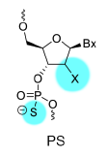
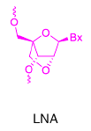
Toxicity of the 1st Generation of ONTs
The First Generation of ONTs (ASOs, siRNAs & miRNAs) developed by several Biotechnology Companies were found to trigger at supra-therapeutic doses in Non-Human Primates:
  Transient activation of blood platelets and of the complement pathway in relation to Phosphorothioate (PS) backbone modifications
  Hepatic and renal toxicity in relation to Locked Nucleic Acid (LNA) sugar modifications
Pre-IND toxicology and safety studies of our first miR-22-3p antagomir APT-110 (a “naked” single stranded 18-mer miR-22-3p antagomir containing PS and LNA modifications, 5’-ln5MeC*-lnT*-dT*-mC*-dT*-dT*-ln5MeC*-dA*-dA*-mC*-dT*-lnG*-dG*-ln5MeC*-lnA*-dG*-ln5MeC*-lnT-3’) were completed in mice and non-human primates according to FDA guidance.
  In mice, APT-110 administered subcutaneously at 15, 60, and 240 mg/kg/dose on Days 1, 3, 5, 8, 15, 22, and 29 was tolerated in vivo and was associated with atrophy of adipose tissues at all dose levels
  In cynomolgus monkeys, APT-110 was administered subcutaneously at 3.75, 15, 37.5 and 60 mg/kg/dose on Days 1, 3, 5, 8, 15, 22, and 29 of the study. A transient activation of blood platelets and of the complement pathway was observed right after subcutaneous administration of supra-therapeutic doses. Kidney and liver histologic alterations were also noted.

Slide 11
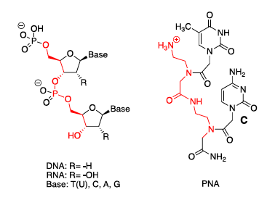
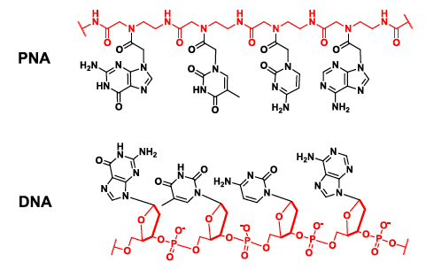
Peptide Nucleic Acid Backbone
Our New Generation 2.5 of targeting ONTs was designed to:
  2. Avoid potential toxicities by replacing PS and LNA modifications by a gamma PNA backbone (PNAs were discovered by Peter Nielsen and Colleagues in 1991)

Slide 12
Peptide Nucleic Acid Backbone Benefits
  3. Maintain resistance to nucleases and proteases/peptidases
  4. Avoid chirality
  5. Limit binding to serum proteins
  6. Optimize and simplify chemical synthesis (solid-phase peptide synthesis including Machine Learning and Ultrasonication features)
  BUT
  The therapeutic utility of PNAs was hindered for decades by their own poor cellular permeability and lack of efficient delivery strategies.
  Recent advances in delivery strategies of PNAs with nanoparticles, ligands, lipid or peptide conjugates, have opened new avenues to improve their efficacy and safety in vivo
  The South Korean drug company OliPass has advanced its PNA drug candidate OLP-1002 into clinical development for the treatment of pain and is developing other PNAs for 5 different therapeutic indications (https://www.olipass.com/front/eng/competitive/pipeline.do).

Slide 13
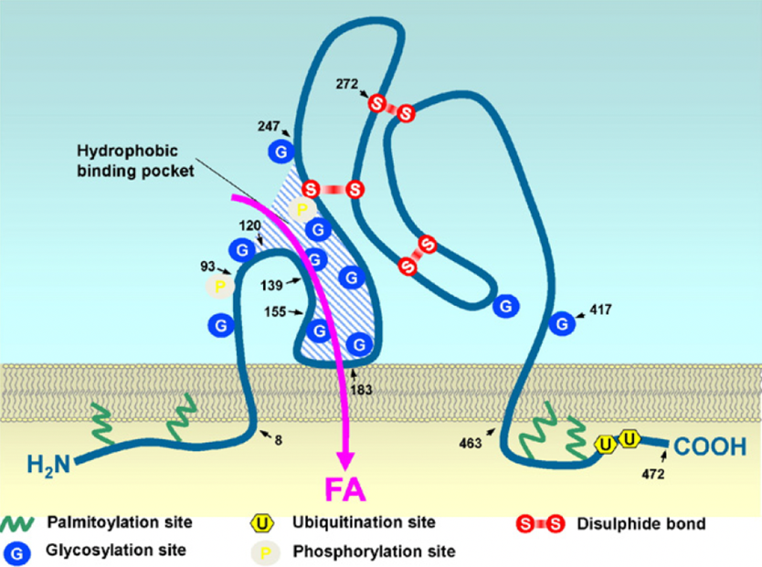
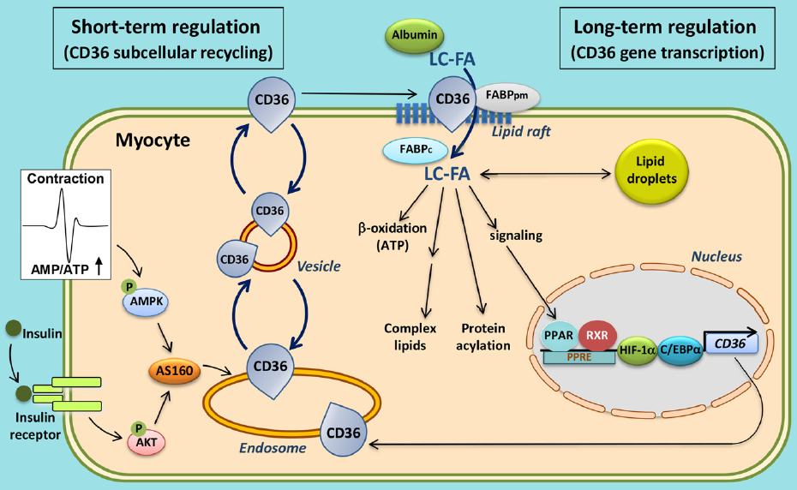
Targeted Delivery of Generation 2.5 ONTs
Selection of the membrane Fatty Acid Translocase (FAT) transporter for active targeted delivery of ONTs to adipocytes and metabolic organs
        The membrane transporter FAT/CD36/SCARB3 is the main route of uptake by adipose tissues of long-chain fatty acids as well as short peptides like Hexarelin, Prohibitin and Thrombospondin Peptide-1
  FAT is expressed in cells and tissues sensitive to metabolic dysfunctions, such as adipocytes, hepatocytes, skeletal and cardiac myocytes, pancreatic β-cells, kidney glomeruli and tubules cells, monocytes and macrophages
  As the average obese male patient weighs around 200 lbs. with 40% being adipose tissue, there is a huge amount of FAT available at the surface of adipose tissues to transport inside the adipocytes our new generation 2.5 of miR-22-3p antagomirs coupled to a fatty acid or a peptide
  Consequently, the effective dose of our generation 2.5 ONTs will be significantly reduced with a greatly improved
  safety and PK/PD profile, especially the mean residence time inside the targeted cells
https://www.ncbi.nlm.nih.gov/pubmed/27090938 https://www.ncbi.nlm.nih.gov/pubmed/29687890

Slide 14
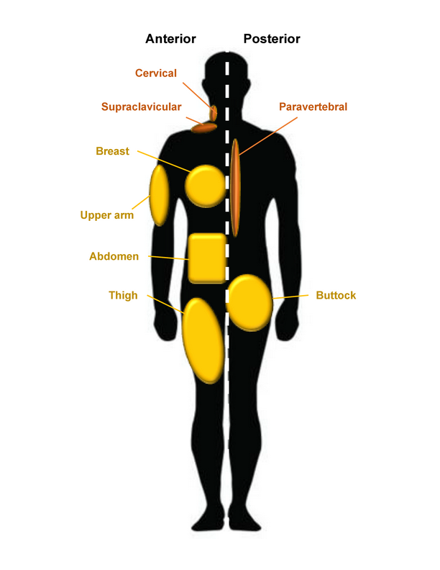
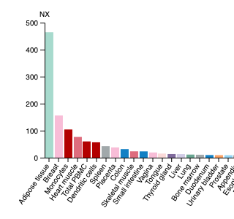
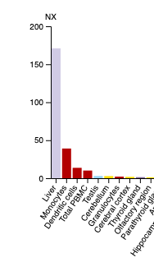
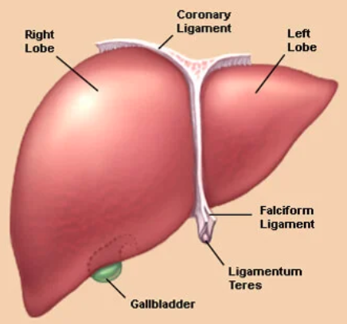
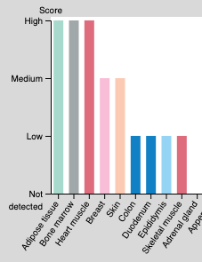
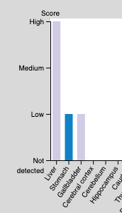
Comparison of ASGR1 and FAT Expression
  mRNA expression levels (www.proteinatlas.org):
  ASGR1 FAT
  Human Liver
  1.5 kg
  Protein expression levels:
  Obese Adipose Tissue
  ASGR1 40% of BW FAT

Slide 15
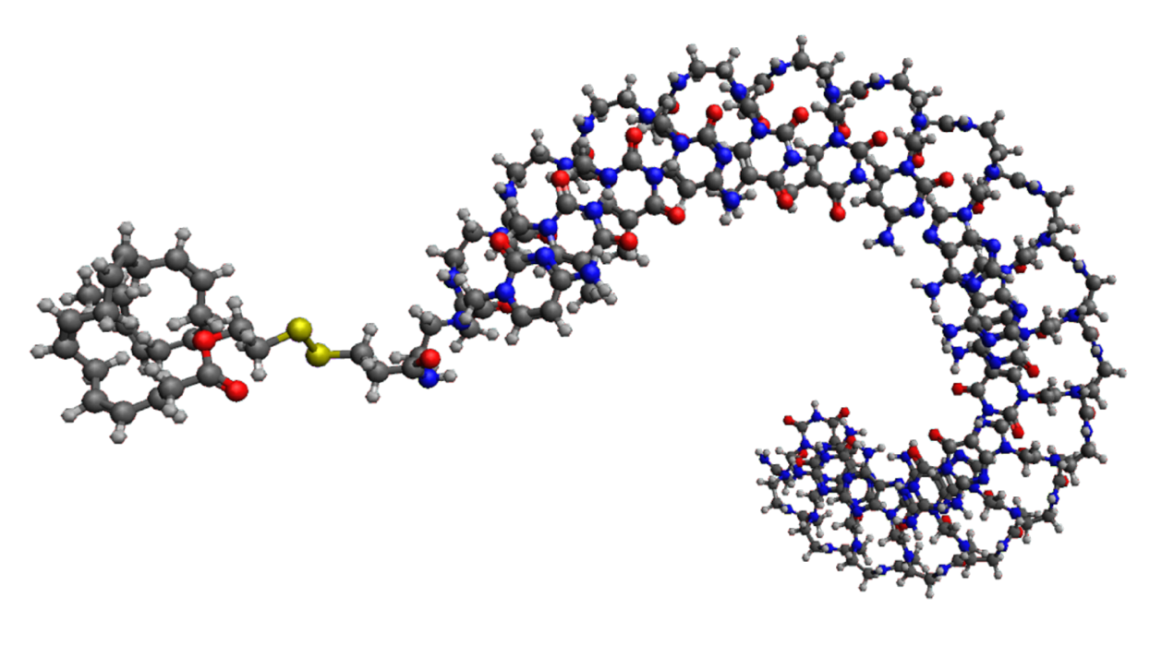
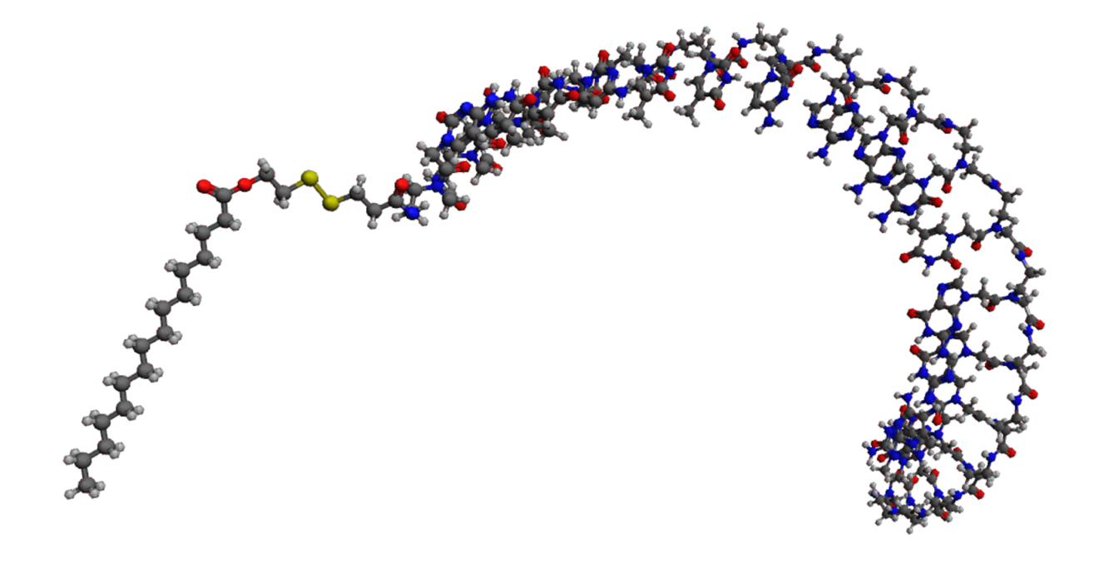
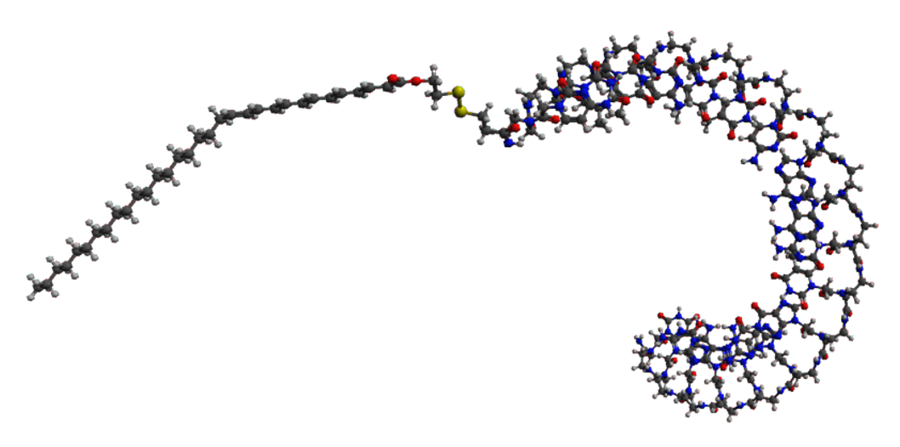
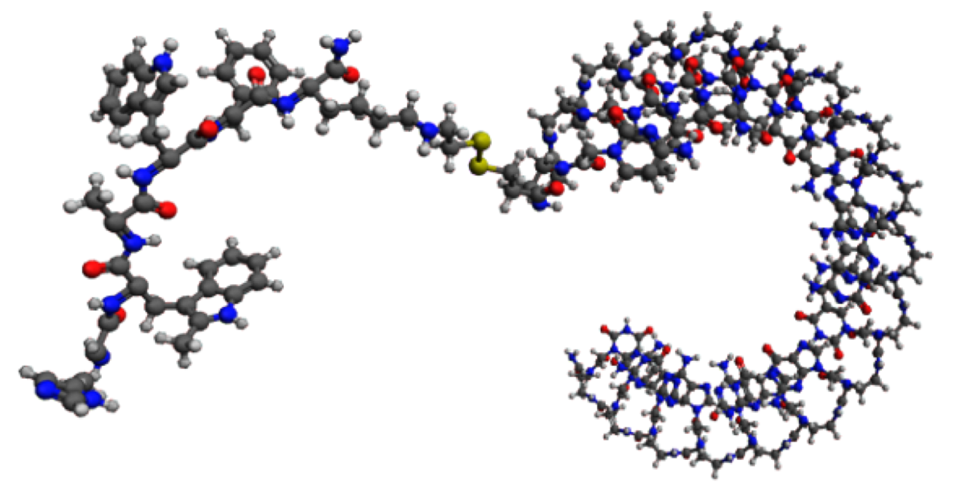
Active Targeted Delivery of the ONT
  7. Conjugation of the ONT to a fatty acid or a short peptide for enhanced targeted delivery to adipocytes and metabolic organs via the cellular membrane transporter Fatty Acid Translocase (FAT) of a greatly reduced effective dose with an extended duration of action (mean residence time, MRT)
18 mer miR-22-3p antagomir with a PNA backbone coupled with the long chain Fatty Acid C16:0 Palmitic Acid
18 mer miR-22-3p antagomir with a PNA backbone coupled with the long chain Fatty Acid C22:0 Docosanoic Acid
18 mer miR-22-3p antagomir with a PNA backbone coupled with the very long chain Fatty Acid C32:6 Dotriacontahexaenoic Acid
18 mer miR-22-3p antagomir with a PNA backbone coupled with the hexapeptide hexarelin

Slide 16
Take-Away Points
AptamiR has already selected and validated miR-22-3p as a good “metabolic target” for the treatment of the Metabolic Pandemics obesity, diabetes and fatty liver disease by completing the pre-clinical development of our first generation of miR-22-3p Antagomirs
AptamiR has established proofs of efficacy of miR-22-3p Antagomirs
  in vitro in primary cultures of human adipocytes and
  in vivo in animal models of obesity and fatty liver disease
AptamiR is currently completing the pre-IND and IND phases for our generation 2.5
of miR-22-3p Antagomirs characterized by several key features:
  Conjugation to a fatty acid or a short peptide for enhanced targeted delivery to metabolic organs and tissues
  Improved PK/PD profile (greatly reduced effective dose with an extended duration of action inside the targeted cells)
  Enhanced safety profile by avoiding chemical modifications leading to activation of blood platelets and of the complement pathway as well as hepatic and renal toxicity
AptamiR’s past and present R&D activities have significantly improved the Probability of Success for the program

Slide 17
Publications/Presentations
Z. Jing, R. Qi, M. Thibonnier & P. Ren. Molecular Dynamics Study of the Hybridization between RNA and Modified Oligonucleotides. Journal of Chemical Theory and Computation. 15(11):6422-6432, 2019
M. Thibonnier & C. Esau. Metabolic and Energetic Benefits of microRNA-22 Inhibition. Oligonucleotide Therapeutics Society, October 13-16, 2019, Munich, Germany
M. Thibonnier & C. Esau, Metabolic benefits of microRNA-22 inhibition. Nucleic Acid Therapeutics, 30(2) 104-116, 2020
M. Thibonnier, C. Esau, S. Ghosh, E. Wargent & C. Stocker. Metabolic and energetic benefits of microRNA-22 inhibition. BMJ Open Diabetes Res Care 2020 Oct;8(1). pii: 8/1/e001478. doi: 10.1136/bmjdrc-2020-001478.
Thibonnier M, Ghosh S, Blanchard A. Effects of a short-term cold exposure on circulating microRNAs and metabolic parameters in healthy adult subjects. J Cell Mol Med. 2021;00:1–15. doi:10.1111/ jcmm.17121
M. Thibonnier. Oligonucleotide Therapeutics with a Peptide Nucleic Acid Backbone to Treat Metabolic Pandemics. TIDES USA, September 20-23, 2021, Boston, MA, USA
M. Thibonnier & S. Ghosh. Targeted delivery of microRNAs OligoNucleotide Therapeutics to Ovarian Cancer cells and their tumor microenvironment for the treatment of human Ovarian Cancer. Oligonucleotide Therapeutics Society, October 2-5, 2022, Phoenix, AZ
M. Thibonnier. One Drug Multiple Targets: Simultaneously Modulating Several targets Genes in Obesity, Diabetes and MAFLD. 7th Obesity & NASH Drug Development Summit, November 29-December 1, 2022, Boston, MA
M. Thibonnier & S. Ghosh. Strategy for pre-clinical development of active targeting microRNA oligonucleotide therapeutics for unmet medical needs. Int. J. Mol. Sci. 2023;24,7126
M. Thibonnier & S. Ghosh. Knock Out of a MicroRNA-Hosting Gene and Pharmacologic Antagonism of its Intragenic MicroRNA Guide Strand Produce Diverse Outcomes. MicroRNA Journal, submitted, 2023
M. Thibonnier. Criteria for developing active cellular targeting microRNA Oligonucleotide Therapeutics. Int. J. Mol. Sci., submitted 2023

